Slide 1


The Musketeers
Medical Insurance Price Prediction
Regression Application
CAHUTAY, STEPHANIE MICAH
CANEDA, GINALYN
PEPITO, ELAIZA FAYE

Slide 2


Medical Insurance Datasets
The Musketeers
Medical Insurance Price Prediction
CAHUTAY, STEPHANIE MICAH
CANEDA, GINALYN
PEPITO, ELAIZA FAYE
Regression Application

Slide 3

Medical Insurance Datasets
Importance of Medical
Insurance Price Prediction
For clients:
Cost Estimation
Affordability
For insurance company:
Plan Design
Health Policy
Source: https://www.kaggle.com/datasets/tejashvi14/medical-insurance-premium-prediction?fbclid=IwAR2SyGKbwfFMxVKcsa2t8jfwg6gCcYWOYUSVOZz4S05zZYPoHhpGf4ijQHQ

Slide 4
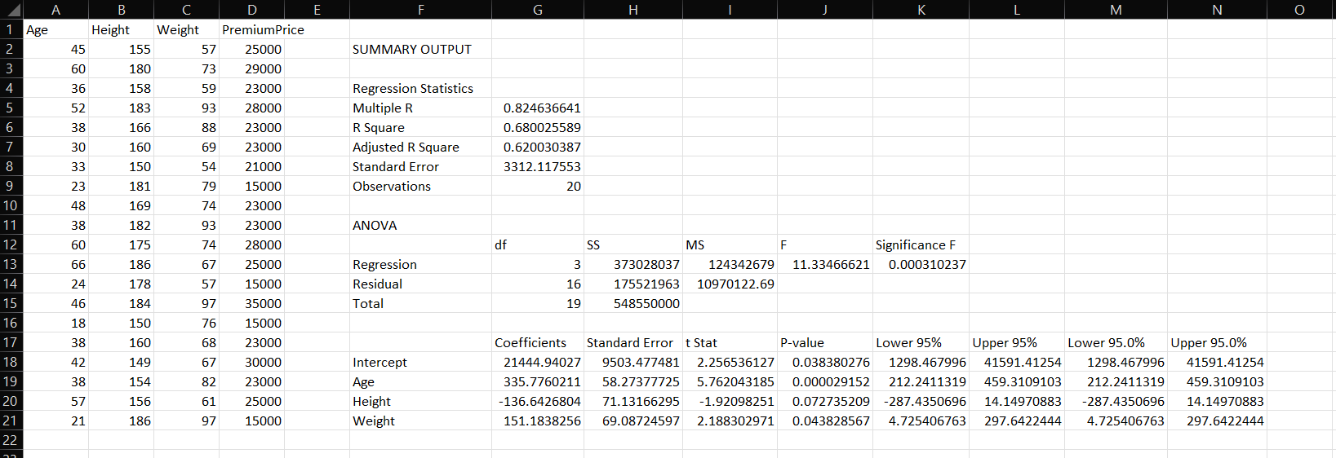

Importance of Medical
Insurance Price Prediction
Medical Insurance Datasets
Let’s try it out
Source: https://www.kaggle.com/datasets/tejashvi14/medical-insurance-premium-prediction?fbclid=IwAR2SyGKbwfFMxVKcsa2t8jfwg6gCcYWOYUSVOZz4S05zZYPoHhpGf4ijQHQ

Slide 5


Let’s try it out
THANK
YOU

Slide 6
Let’s try it out
THANK
YOU
PEPITO, ELAIZA FAYE

